Slide 1
Culturally Responsive Instruction
Gibbs High School

Slide 2
Welcome and Introductions

Slide 3
Four Agreements
Stay engaged.
Speak your truth.
Experience discomfort.
Except and accept non-disclosure.

Slide 4
What Makes Teaching Good?
Notes:
Basically, for kids to learn, they need this above! Gathering should be quick. Majority should be in processing.
Not generally time for students to Store/Retrieve info.

Slide 5
What Makes Teaching Great?
STRATEGIC GATHERING
PURPOSEFUL PROCESSING
RELEVANT RETRIEVAL
Notes:
Discuss what distinguishes this from “good” teaching.
Strategic gathering- teacher example of “adapting” using the word w/out going over what it meant, students figured it out
Purposeful- they know why you are reading, what is it at the end that you'll be able to do?
Retrieval- something more than multiple choice, debate, project, create a rap, etc

Slide 6
What Makes Teaching Culturally Responsive?
A conscientious and active approach to meeting the needs of diverse learners
Effectively and consistently incorporating aspects of their students’ unique cultures into instruction
Supporting all students in making relevant connections between their everyday life experiences and the formal content to which they are exposed at school
Notes:
Culturally responsive instruction is an extension of great teaching, not something separate.
Has to be intentional, and constant, helping them make connections to their selves and their life

Slide 7
Identity Molecule
3 mins
Notes:
Who are you? What makes up your identity? Fill out the bubbles based on you (wife, mother, teacher, White, Christian, Jewish, Black, friend, etc)

Slide 8
Culturally Responsive Instruction looks like…
Classroom relationships characterized by mutual respect and care
High expectations for learning with scaffolded support
A balance of explicit instruction and authentic application
Notes:
Standards are high but scaffolding is set
Authentic application= purposeful processing, relevant retrieval, connected to knowing your kids and what matters to them/is interesting to them, taking the standard and making it authentic

Slide 9
Culturally Responsive Instruction looks like…
Planned learning experiences that incorporate the assets, funds of knowledge, interests, and strengths of students
Instructional conversation and discourse
A variety of formative assessment practices

Slide 10
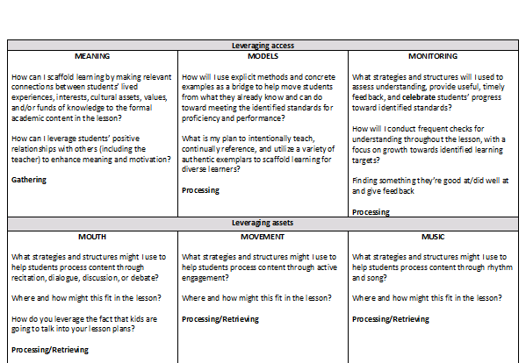
How Does This Apply?
Notes:
Present and discuss each of the 6 Ms, giving examples.
Also elicit other examples from participants.
Models= shouldn’t always be things in the textbook, think of their neighborhoods, the music they listen to etc, different examples of excellence that are diverse culturally

Slide 11
Your turn
Please spend time reworking a lesson plan you’ll be doing at the start of the school year to include the 6 Ms.
You may work alone or work with your team.
Team= teachers with whom you plan lessons

Slide 12
Share Out
What are additions you’re excited about?

Slide 13
GATHER
Visual instruction _____
Dramatic instruction_____
Stories/interesting anecdotes_____
Linking to previous, familiar content_____
Preview questions (i.e., “At the end of the lesson, we will be able to answer these questions…”_____
Teacher summary of key ideas to be presented_____
“Skimming”/previewing text_____
Games focused on academic content_____
Novelty/unusual facts or information_____
PROCESS
Grouping in pairs or triads_____
“Chunking” information/content _____
Descriptions, discussions, and predictions _____
Reciprocal teaching_____
Jigsaw Tasks_____
Examples and non-examples_____
Similarities and differences_____
Analogies_____
Venn diagrams_____
Similes and Metaphors_____
Visual representations_____
Identifying errors (error analysis) _____
Supporting claims with evidence_____
Hypothesis testing/inquiry/investigations_____
Authentic problem solving_____
RETRIEVE
Using varied question structures_____
Wait time/pause time_____
Response cards_____
Presentations_____
Projects_____
Debate_____
STORE
Dramatic tasks_____
Questioning for elaboration (“Why?” What would happen if…?”)_____
Journaling/writing questions and thinking_____
Note-taking_____
Drawing pictures_____
Graphic organizers_____
Distributed practice over time_____
Interactive homework/notebooks_____
Non-linguistic representations_____

